Slide 1
Using Tableau with the Digital Humanities
Given 11/30/2018 at the Digital Humanities Presentation at Bryant University by Rachael Juskuv, Research & Instruction Librarian

Slide 2
What is this program?
It’s called a Business Intelligence tool
And there are more!
You may not be able to learn all the tools-- but you can learn the skills of data analysis and visualization.

Slide 3
Free for academic use!
You can download and use the public version for free
Students with an .edu email can request access to the full version for a year.
Faculty can request access for a full class for the year

Slide 4
Making Sense of Data
Knowing “how-to” is only the first part

Slide 5
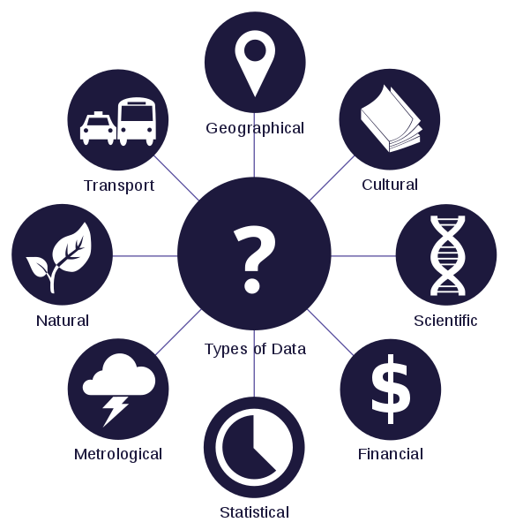
Taken from Wikimedia Commons

Slide 6
Source: FlowingData-- WTF visualizations

Slide 7
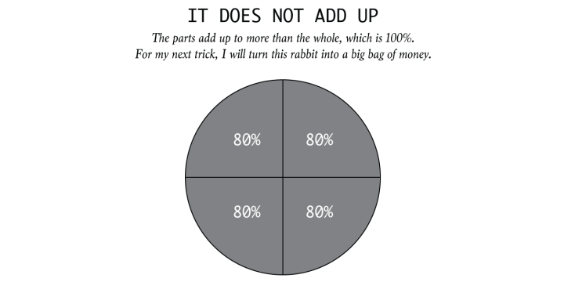
Source: How to Spot Visualization Lies
-- Nathan Yau

Slide 8
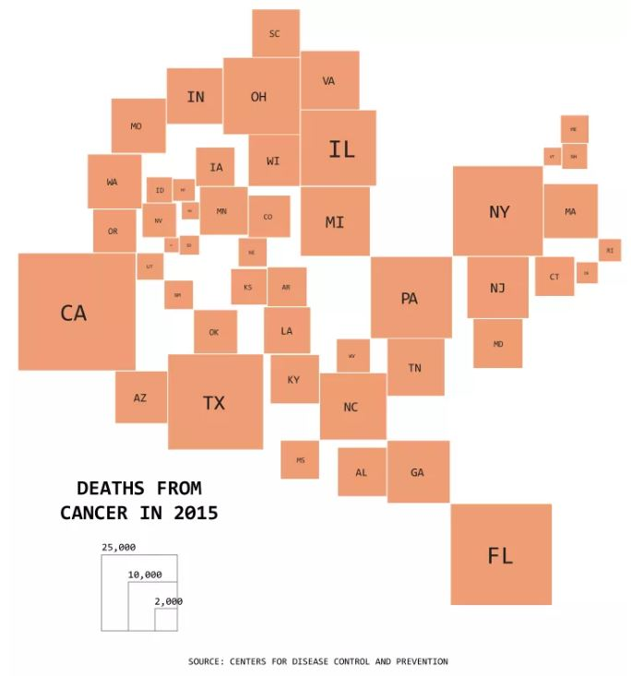
Source: FlowingData- Useless Data Comparisons

Slide 9
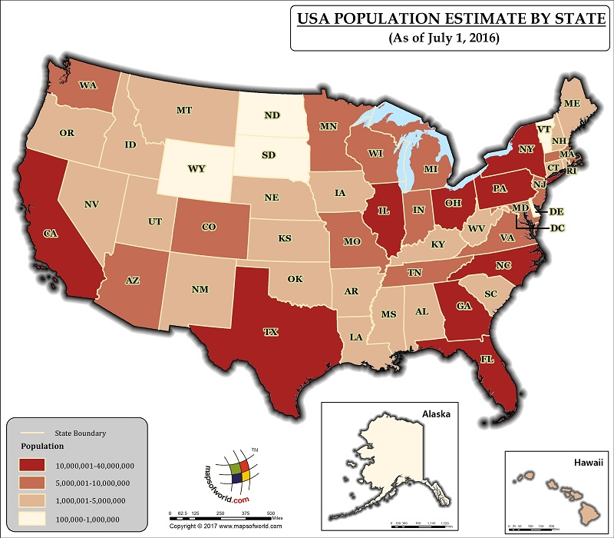
Source:mapsoftheworld.com

Slide 10
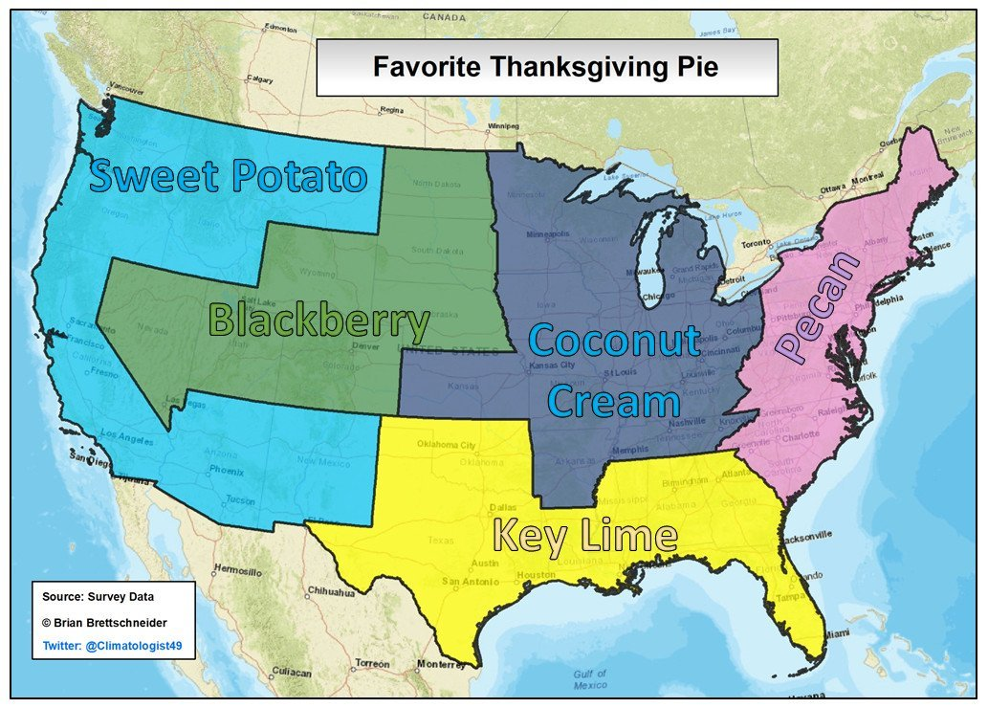
Read “Lessons from posting a fake map”

Slide 11
I’m doing a lot this semester with this class. How can I teach this and everything else?

Slide 12
Teaching Tools
Self Training
These training videos created by Tableau, includes downloadable workbooks, solutions and transcript that go along with the video. These videos are accessed using a self-created login.
Also useful: Tableau Starter Kits -a step by step guide and Tableau Solutions Gallery - download the workbooks to see how they made the graphs

Slide 13
Need free datasets?
University of MI Free Data List
Simmons Open Access Data
RI Open Data
MA Open Data
CT Open Data
US Health Data
World Bank Open Data
Bryant Data Research Guide

Slide 14
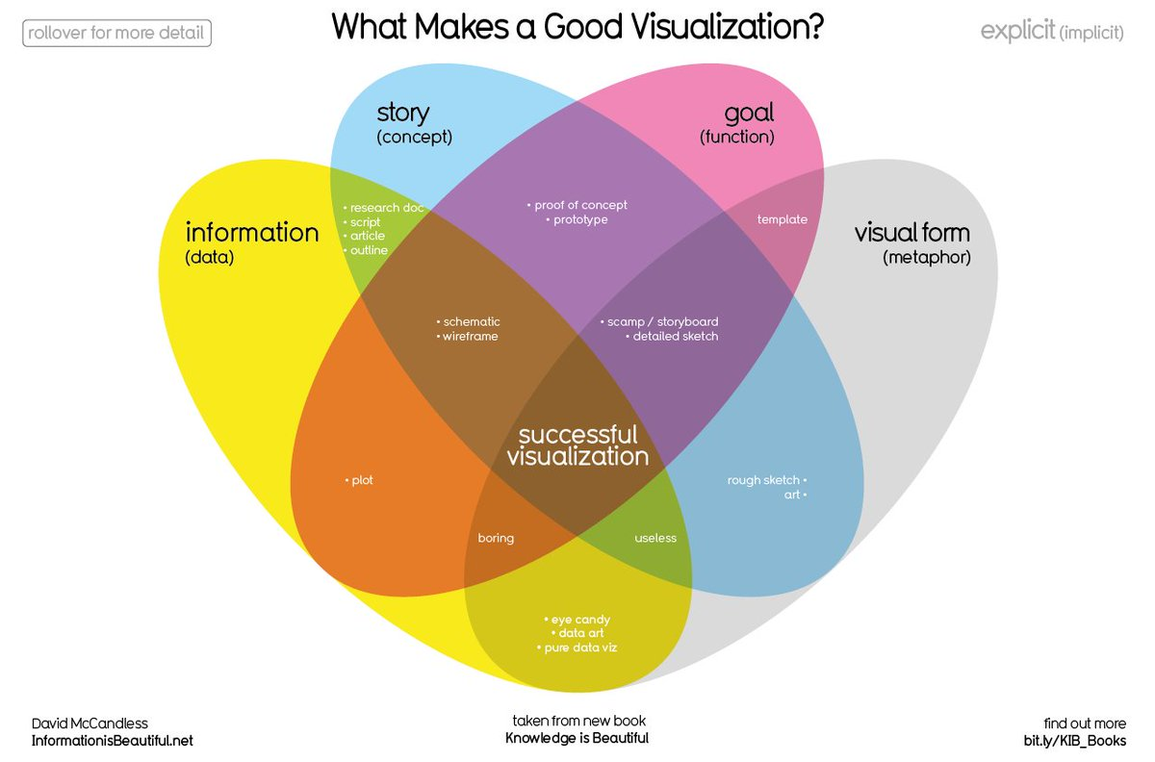
Full List of Resources
Thanks!

